Slide 1

Our price offer: A07616000_B
Automatic production line for wire processing
02.07.2025
Lisa Dräxlmaier / Satu Mare
Contact person Gluth:
Contact person Dräxlmaier:
Florian Schötz
Technical sales
E-Mail: schoetz.florian@gluth.eu
Tel : +49 9421 / 544-965
Mobil : +49 151 / 20832983
Radlbeck Ulrich
Technical sales
E-Mail: radlbeck.ulrich@gluth.eu
Tel: +49 9421 / 544-56
Mobil: +49 171 / 9493494
Thomas Eglseder
Purchase
E-Mail: Thomas.eglseder2@draexlmaier.com
Tel : +49 8741 / 47 3574
Mobil : +49 152 / 2800 4115
Juhasz Levente
Engineering
E-Mail: Levente-istvan.juhasz@draexlmaier.com
Tel : +40 723 / 100 146
Mobil :

Slide 2
Table of contents
Basics offer
Task description
Concept / Layout
Overview Processes
Control System
Performance criteria
Scope of delivery
Supplies Dräxlmaier
Miscellaneous
Project Schedule
Project Prices

Slide 3
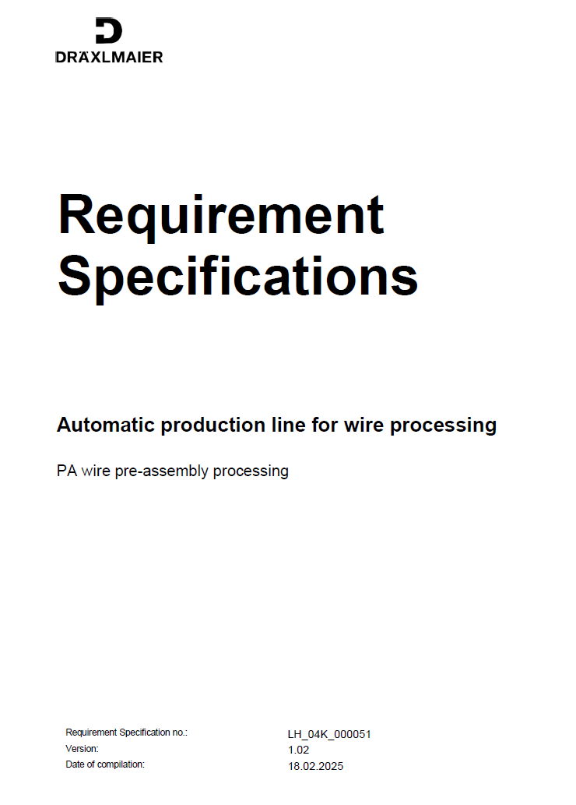
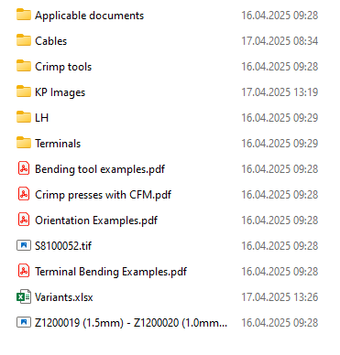

Basics
Specifications received:
Order documents received:
At the time of preparing the quotation, we had no further data on your products!
Should significant changes or additions to the current range of types arise in the course of the project, we reserve the right to offer these at a later date, with possible effects on price and delivery time, after consultation with you.

Slide 4
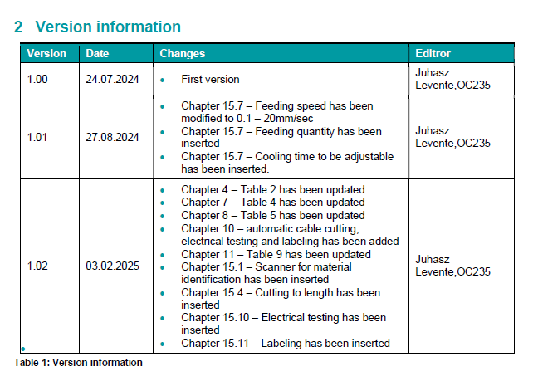
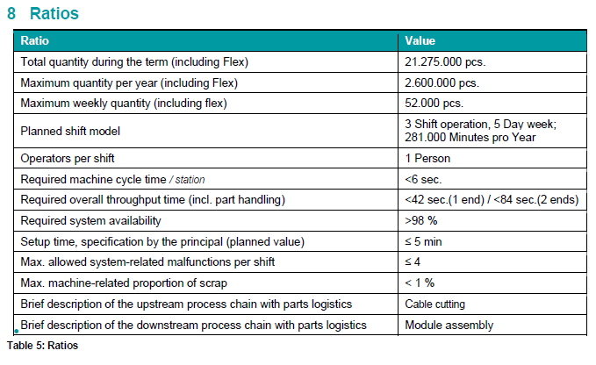
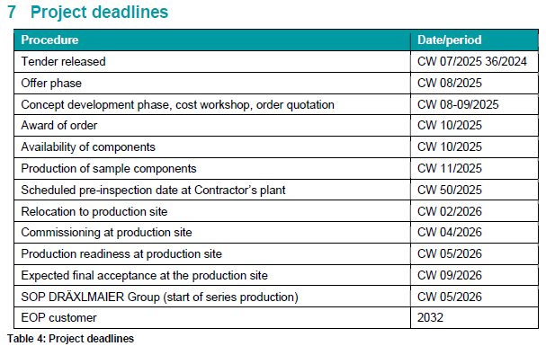
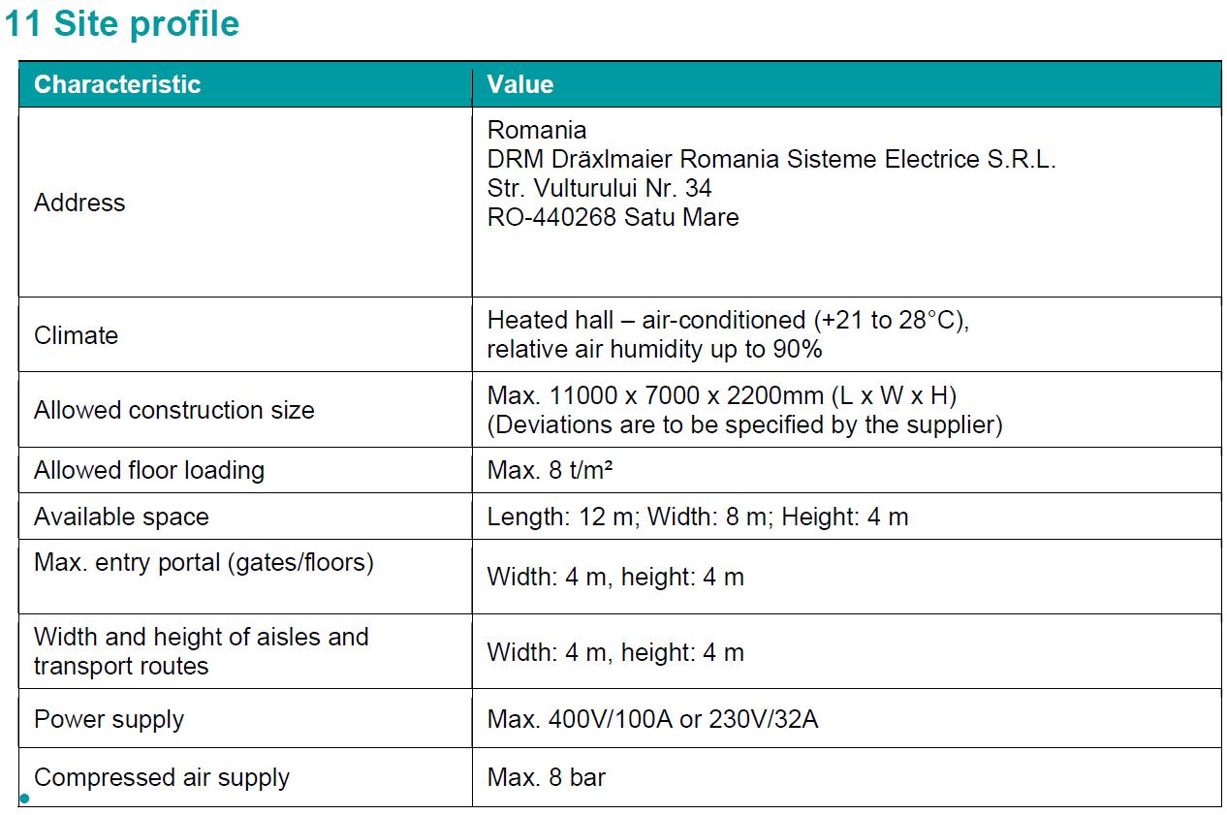
Basics

Slide 5
Change history offer
Change history offer:
Angebotsversion | Datum | Verantwortlicher | Änderungen | Bemerkungen
A07616000 | 08.10.2024 | Rudolf Schano |  | Budget price offer
A07616000_A | 17.06.2025 | Florian Schötz | Adjustments to specification V1.02
A07616000_B | 01.07.2025 | Ulrich Radlbeck | Output with boxis added, Description for shrink sleeve and labeling added Layout updated Payment terms and price updated

Slide 6

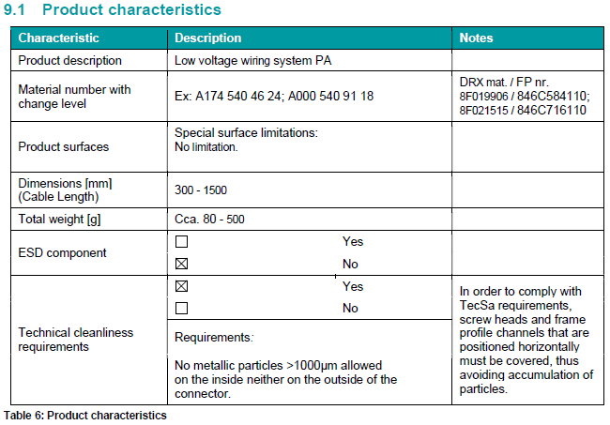

Task description

Slide 7
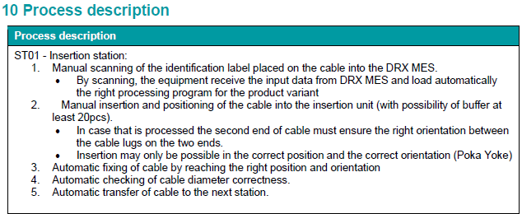
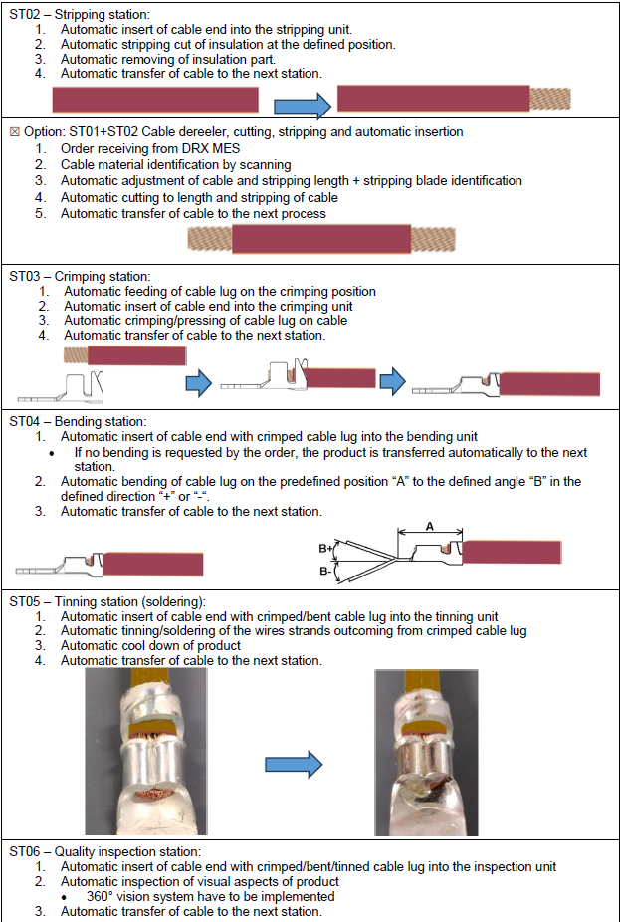
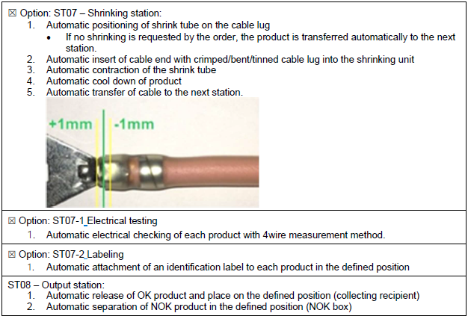
Task description

Slide 8
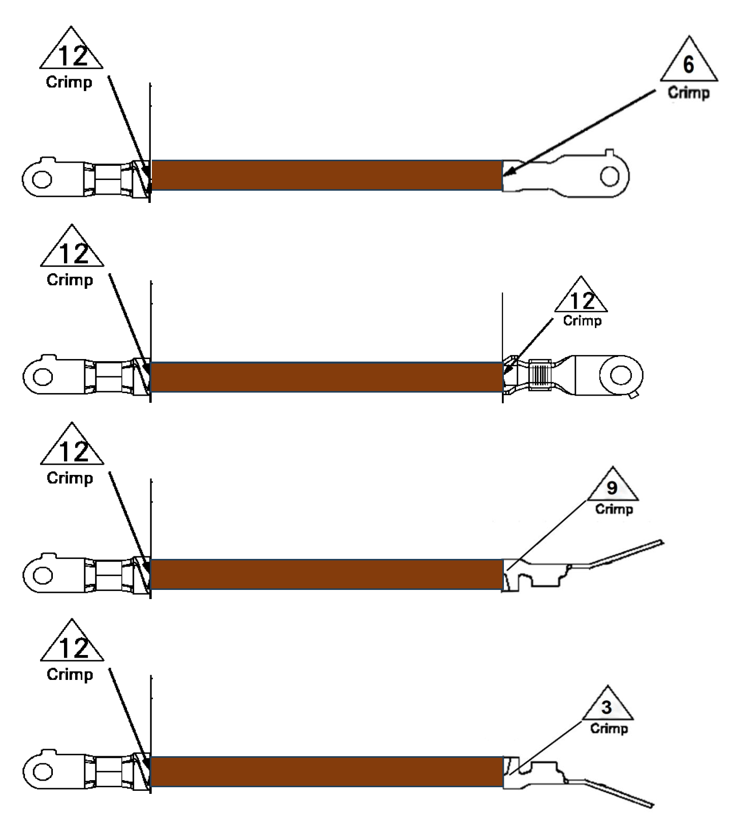
Task description
Different Orientations Crimp 1 and Crimp 2
Different Types Crimp 1 and Crimp 2
Different Crimping Tools
Two crimping stations
16mm² ➔ 6 Seconds target
Longer Time for bigger cross sections!

Slide 9
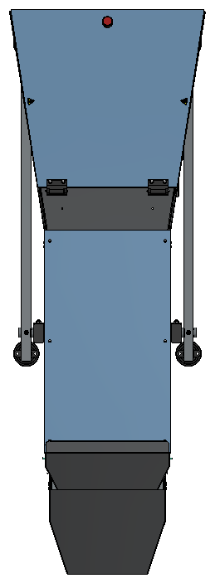
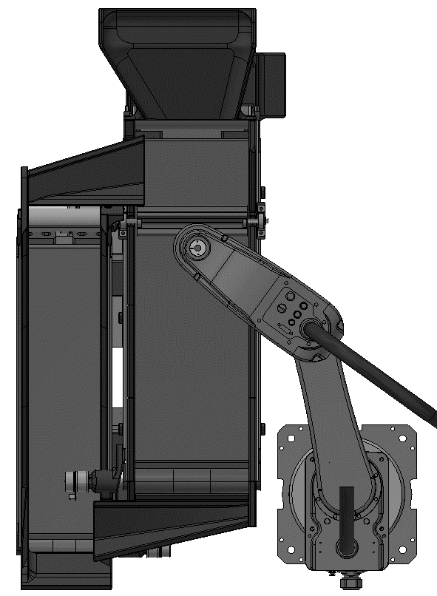

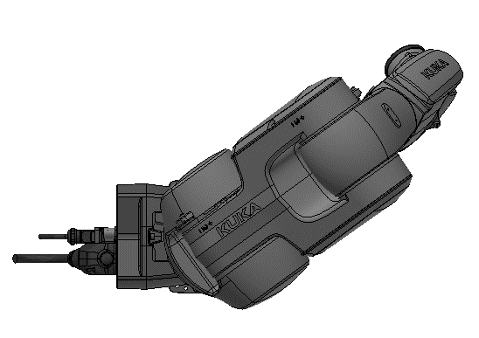
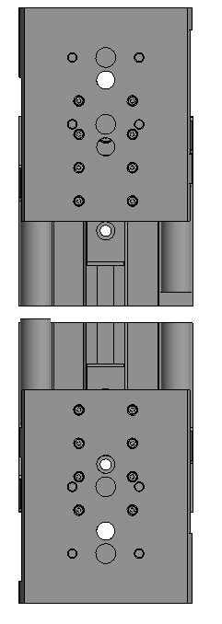
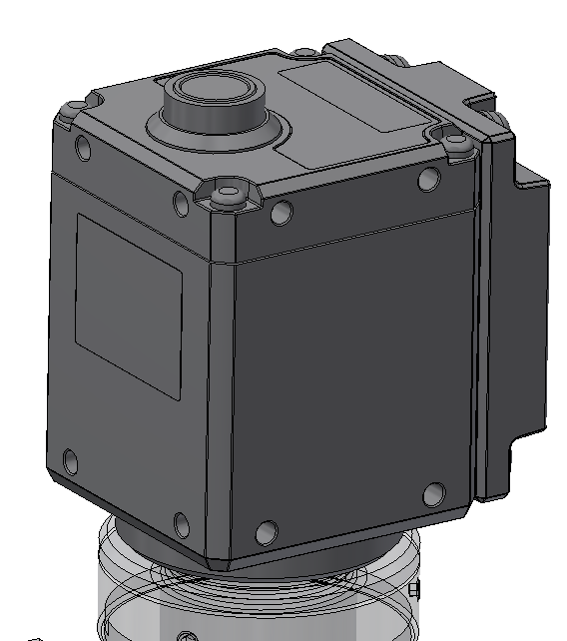
Layout / Concept
Induction
Generator
Cooling Generator
Clear Path to
Crimping station for
changing Crimping Die
1
2
3
4
5
6
7
8
9
10
11
12
13
14
15
16
17
18
19
20
NOK
Clear Path to
Crimping station for
changing Crimping Die
Suction
unit for both
Tinning station
Suction unit
for both station
and cutting
Protective Fence
Cuting
1 Cutting cable
2 Removing Isolationpart Terminal 1
3 Free Station
4 Feeding Terminal 2 and Crimping 1
5 Free Station
6 Bending Terminal 1
Tinning 1 Terminal 1
Optical Inspection Terminal 1
9 Turning station Terminal 1 to 2
10 Turning Position Terminal 2 3-6-9
Insert Shrinksleeve (Option)
12 Removing Isolationpart Terminal 2
13 Free Station
14 Feeding Terminal 2 and Crimping 2
15 Free Station
16 Bending Terminal 2
17 Tinning 1 Terminal 2
18 Optical Inspection Terminal 2
19 Labeling (Option)
20 Output Cable

Slide 10
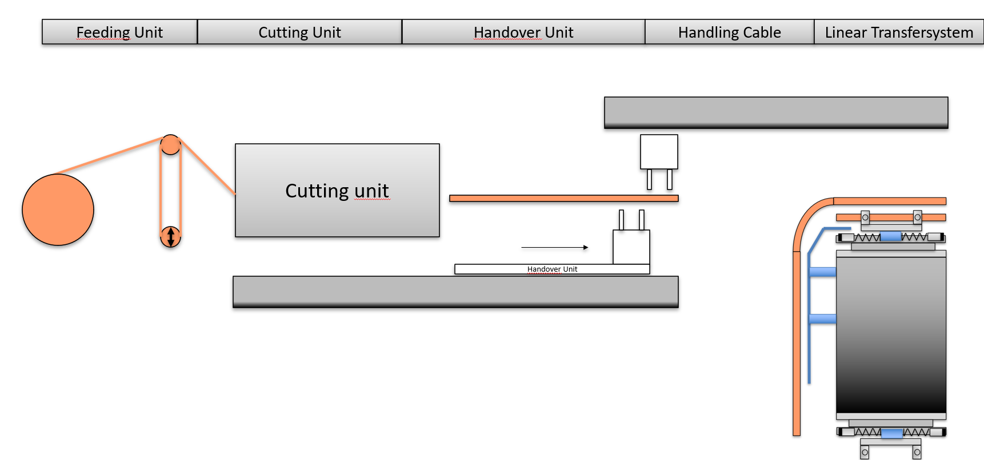
Insert and cutting Cable
Station consisting of:
Automatic cable unwinder for tension-free material feed for all 3 named cable cross-sections
Cutting unit
  For all cable types (acdording to specification)
  Electric feed
  Cable length from 150mm to 1500mm
  Knife: V-shape for all cable types
Handover unit
  Pneumatic Cylinder y-stroke
  Pneumatic Gripper
Handling Cable in WPC
  Pneumatic Cylinder y-stroke
  Pneumatic Cylinder z-stroke
  Pneumatic Gripper
Base frame
Suction unit
  Opener Unit for WPC
  2x pneumatic cylinders to open the gripper jaws on the WPC

Slide 11
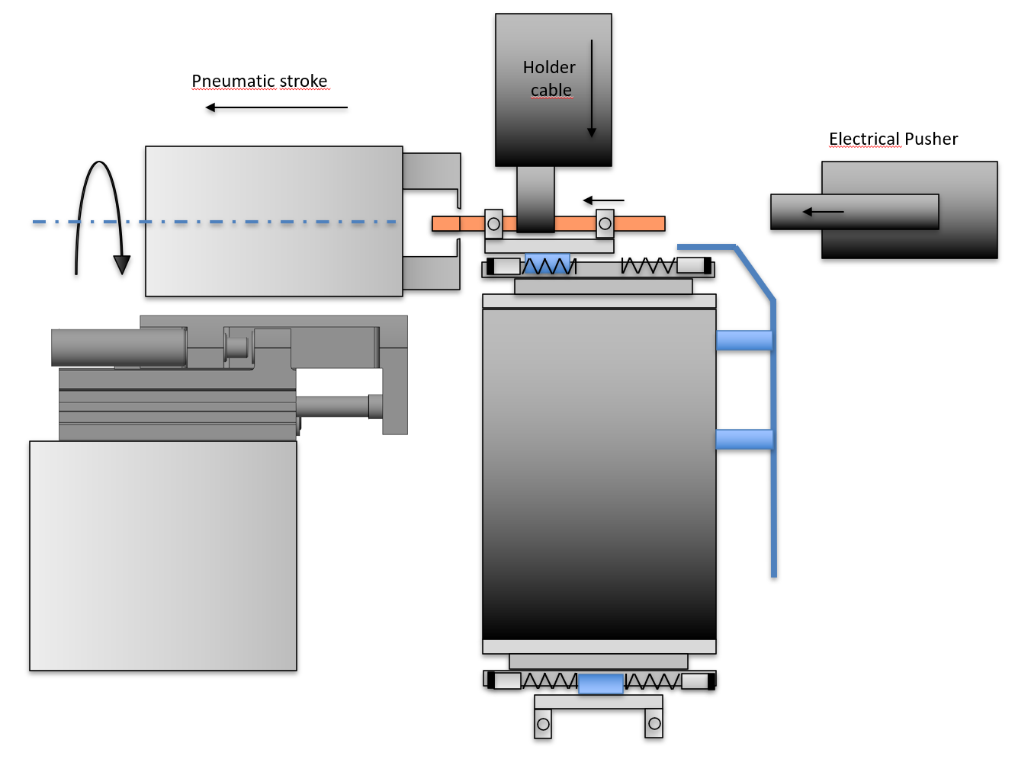
Stripping Cable
Station consisting of:
Cutting and Pull Unit for Isolation Part
  Pneumatic Extraction cylinder
  Pneumatic gripper with interchangeable knives
  2 knifes Typ: V-blades included in the basic scope
  Turning unit pneumatic
  Holder Cable
  Pneumatic Cylinder
  Pneumatic Gripper
  Universal Gripper fingers for all cable types
  Electrical Pusher
  Electrical cylinder for positioning cabel
  freely adjustable in 0,1mm steps
  Extraction of the insulation ends and resulting protection
  Suction unit size designed for 1-shift
  Base frame

Slide 12
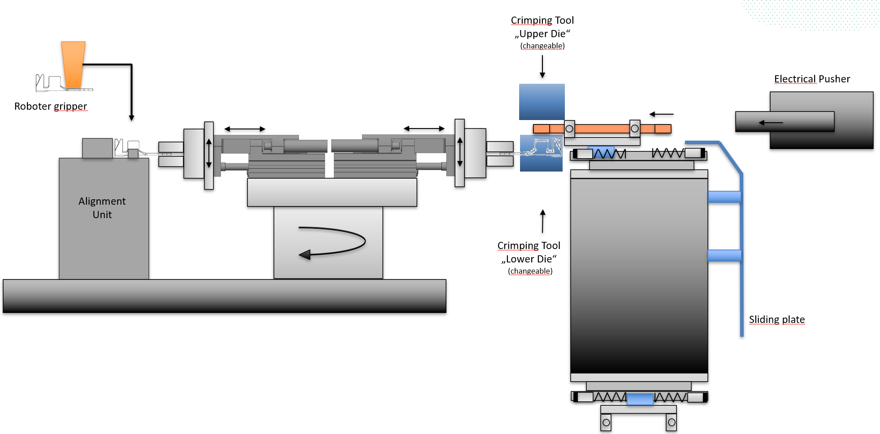
Crimping Unit
Station consisting of (including in the offer):
Feeding Unit
  Automatic feeding unit for all types of cable lugs
  Cable lug hopper for 2 hours
  Camera for position detection
  Scara robot
  Universal gripper for all types
  Alignment Unit
  Universal alignment unit for all typs
  Pneumatic gripper for centering cable lug
  Handover station for cable lug
  Pneumatic 180° turning unit
  2 pneumatic zylinder for delivery cable lug
  2 pneumatic gripping unit with floating unit
  Electrical Pusher
  Electrical cylinder for positioning cabel
  freely adjustable in 0,1mm steps
  Crimp station
  Basic structure
  Electromechanical NC joining module Fa Kistler 0-25KN
  Crimp tool from Schäfer (according to specification) (supplied by Dräxlmaier)
  Coding for crimp tool
  Base frame
  Welding console
  Base plate

Slide 13
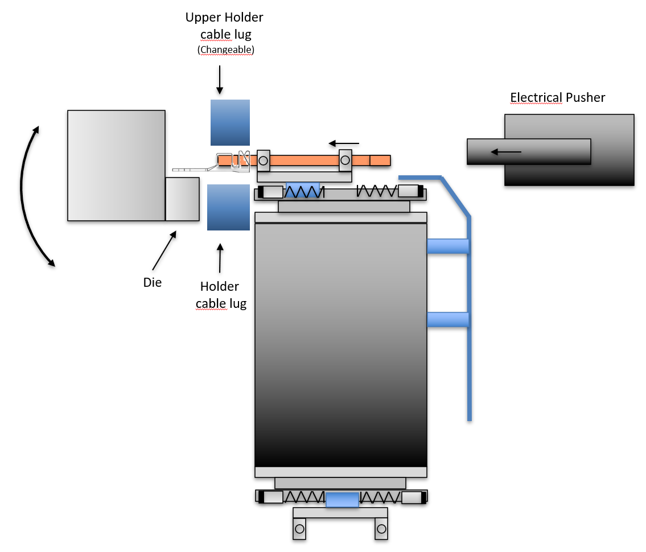
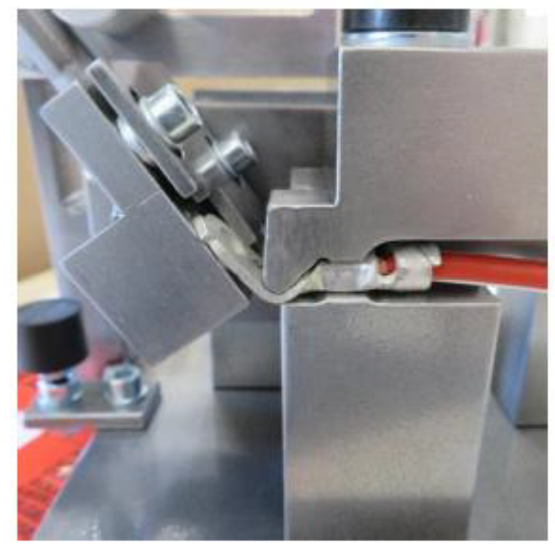
Bending Unit
Station consisting of:
Fixing unit for cable lug
  Pneumatic clamping unit
  Interchangeable jaws
  Coding for jaws
  Bending unit
  Electrical swivel unit
  Adjustable from -90° till +90°
  Electrical Pusher
  Electrical cylinder for positioning cabel
  freely adjustable in 0,1mm steps
  Base frame

Slide 14
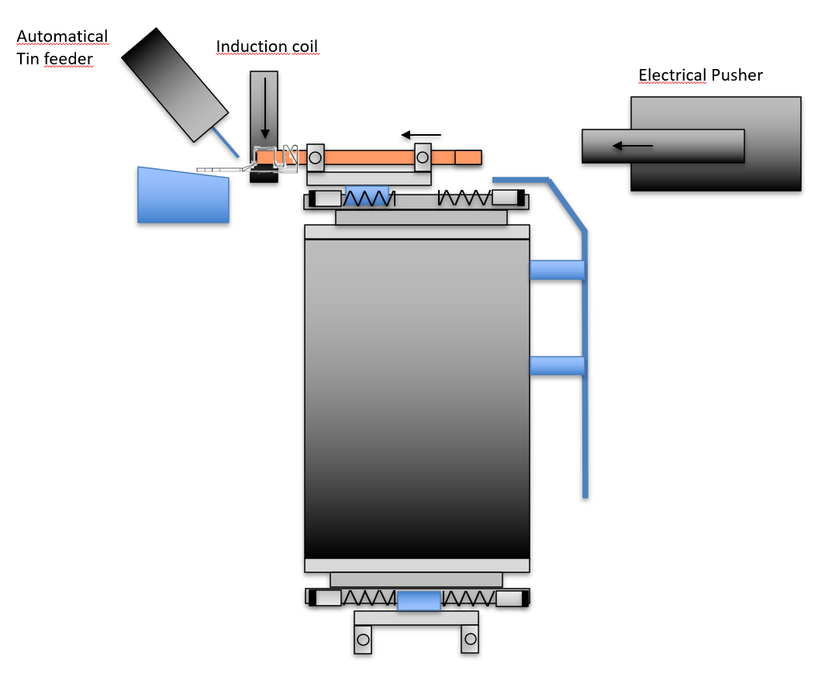
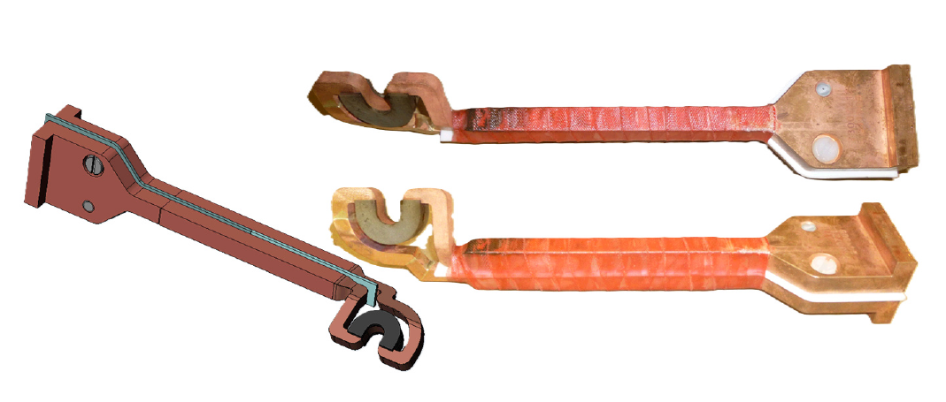
Tinning Unit
Station consisting of:
Automatical tin feeding unit
  Wire length and dispensing speed are customizable
  Feeding of tin material Ø0.75 – 3.00 mm
  x-y-positioning unit for tin supply (+/- 10mm)
  Induction coil
  Heating temperature adjustable (ca. 20°steps are possible!)
  Heating time ist adjustable
  Induction generator / output power 30 kW HF
  Inductor
  Cooling unit
  Electrical Pusher
  Electrical cylinder for positioning cabel
  freely adjustable in 0,1mm steps
  Suction unit
  Base frame
  Note: Exact cycle time could not yet be determined. Too many different parameters that have to be
  matched to each other.
  - Which heating temp for different types
  - Which tin diameter is the optimum for different types
  - Tin quantity --> different for each type
  - Tin feed speed
  Interaction of all parameters for all different types can only be determined during commissioning. This can lead to a longer cycle time!

Slide 15
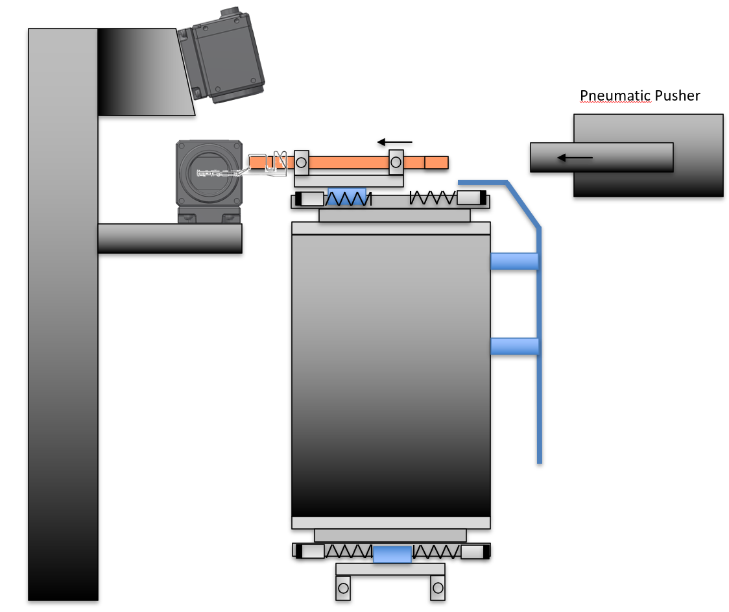
Visual Inspection Terminal
Station consisting of:
Camera unit
  2x Baumer VCXG.2-127M
  Connection cable (Netzwerk + IO), 10m
  Lighting
  Controller + SW-Paket + Zub RELISTE VisionController + RELISTE EasySightPro + Cognex VisionPro + 24" Monitor + Keyboard/Mouse
  Network cards Camera integrated
  Profinet-card
  1x 8TB hard disk integrated in controller
  Solid camera frame
  Decoupled from the machine
  Firmly anchored on the floor
  Electrical Pusher
  Electrical cylinder for positioning cabel
  freely adjustable in 0,1mm steps
  Housing (darkened chamber)
  Currently not planned and therefore not included in the scope of delivery
  (no sample parts available for quotation)
  Darkened chamber included.
Note: The camera job could not yet be tested, as no sample parts are available yet!
No statement can yet be made about the selectivity of IO/NOK
Dräxlmaier has not yet provided a precise definition of NOK

Slide 16
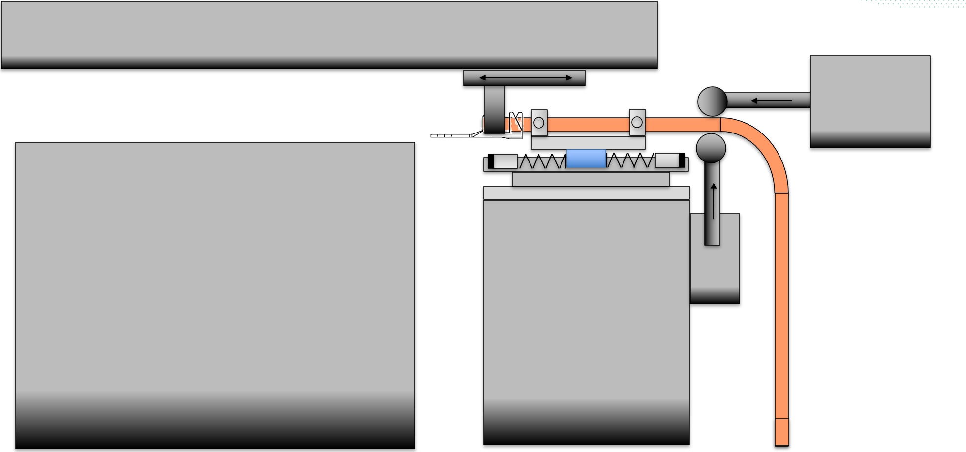
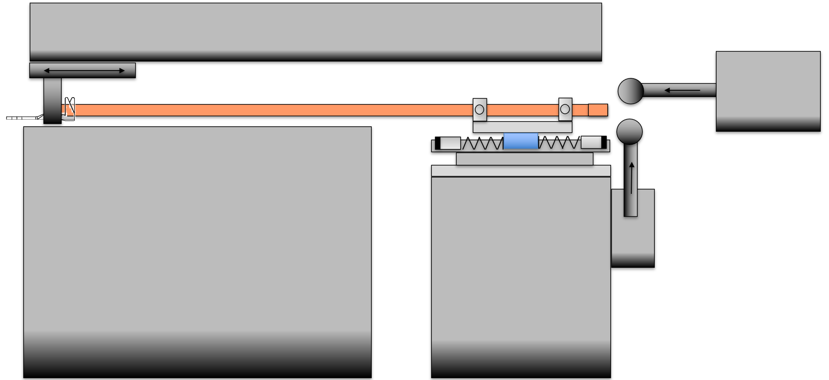
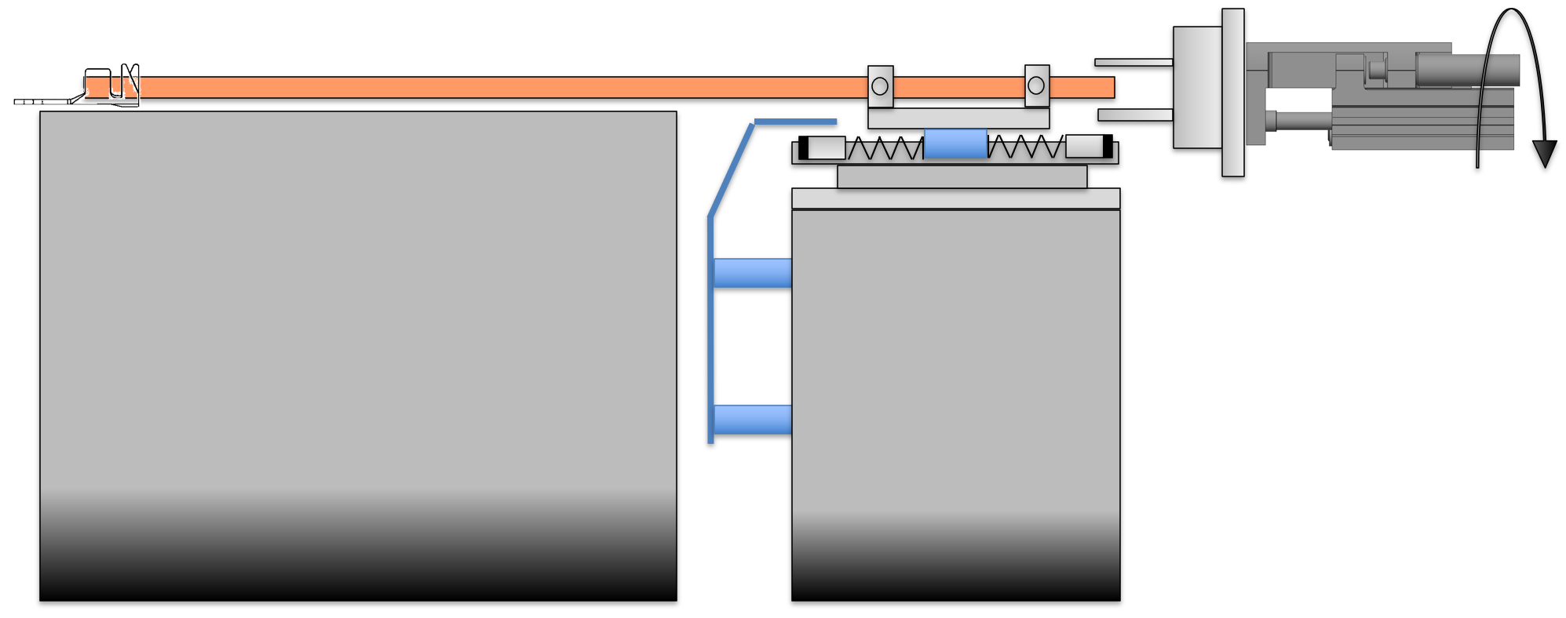
Change Unit from Terminal 1 to Terminal 2
Station consisting of:
Support unit cable
  2x roller guide units pneumatically delivered
  Pull unit
  Electric pull axis
  Pneumatic gripper
  Universal Gripper fingers for all cable types
  Axis frame
  Opener Unit for WPC
  2x pneumatic cylinders to open the gripper jaws on the WPC
  Pneumatic pusher
  2x pneumatic pushers that push the cable to the side when conveying it to the next station
  Base frame
Turning Unit for Terminal 2
Station consisting of:
Turning unit
  Pneumatic turning unit
  Pneumatic gripper
  Universal Gripper fingers for all cable types
  Opener Unit for WPC
  2x pneumatic cylinders to open the gripper jaws on the WPC

Slide 17
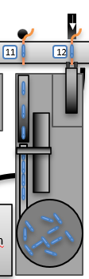
Insert Shrink Sleeve
Station consisting of:
Bowlfeeder for shrink sleeve with separator for 1 Typ
Handling unit for shrink sleeve
  Pneumatic gripper for 1 Shrink sleeve type
  Y-axis electric
  Z-Axis Pneumatic
Opening Unit for WPC
Fixing unit for Cable while Clamping unit is open
Note: Shrink sleeves are bulk material and have to be stable and ready for automated feeding.

Slide 18

Labeling
Station consisting of:
Label printer Typ HERMES for 1 label typ
Flag applicator
  Note: 1 fix position for label on the cable for all typs has to be defined!

Slide 19
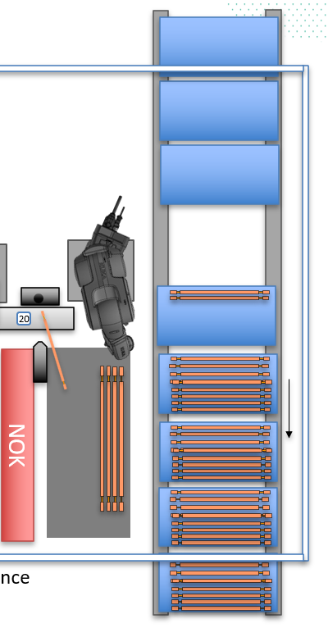
Output Cable
Station consisting of:
Support unit cable
  2x roller guide units pneumatically delivered
  Pull unit
  6-axis Robot with base frame
  Pneumatic gripper
  Universal Gripper fingers for all cable types
  Opener Unit for WPC
  2x pneumatic cylinders to open the gripper jaws on the WPC
  Catch Tray NOK cable
  Catch Tray OK cable for cable > 350mm
  Conveyor system
    for standard KLT containers with a size of 300x400x300mm
    4 empty KLTs before the loading station
    4 full KLTs after the loading station
    KLTs must be removed from the transfer belt by hand
    Stopp position for the loading station
  Base frame
Note: Cables up to about 350mm are delivered to the KTL containers. Longer cables are delivered to the cable catch tray and have to be unloaded manually.

Slide 20
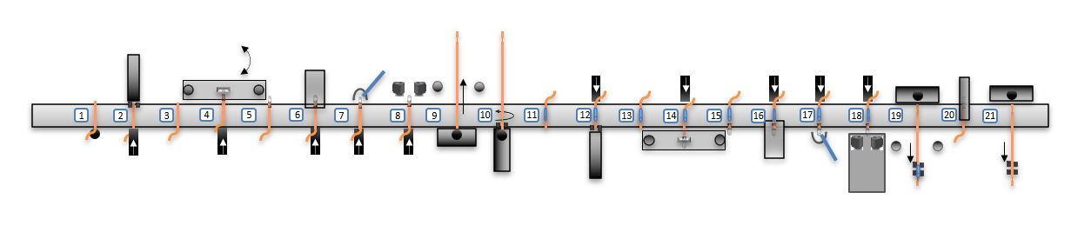
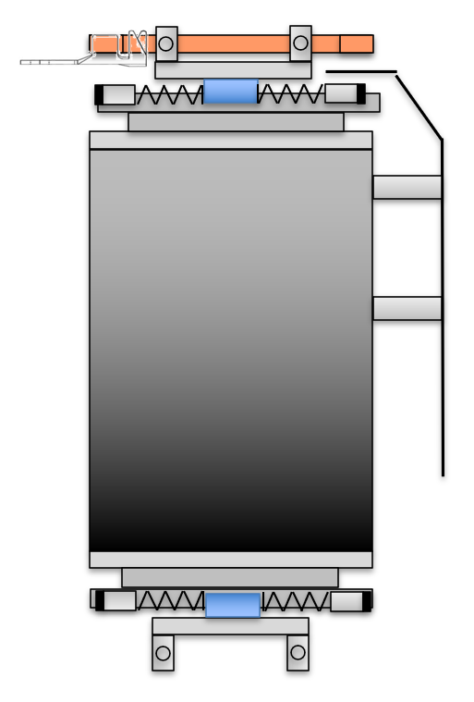
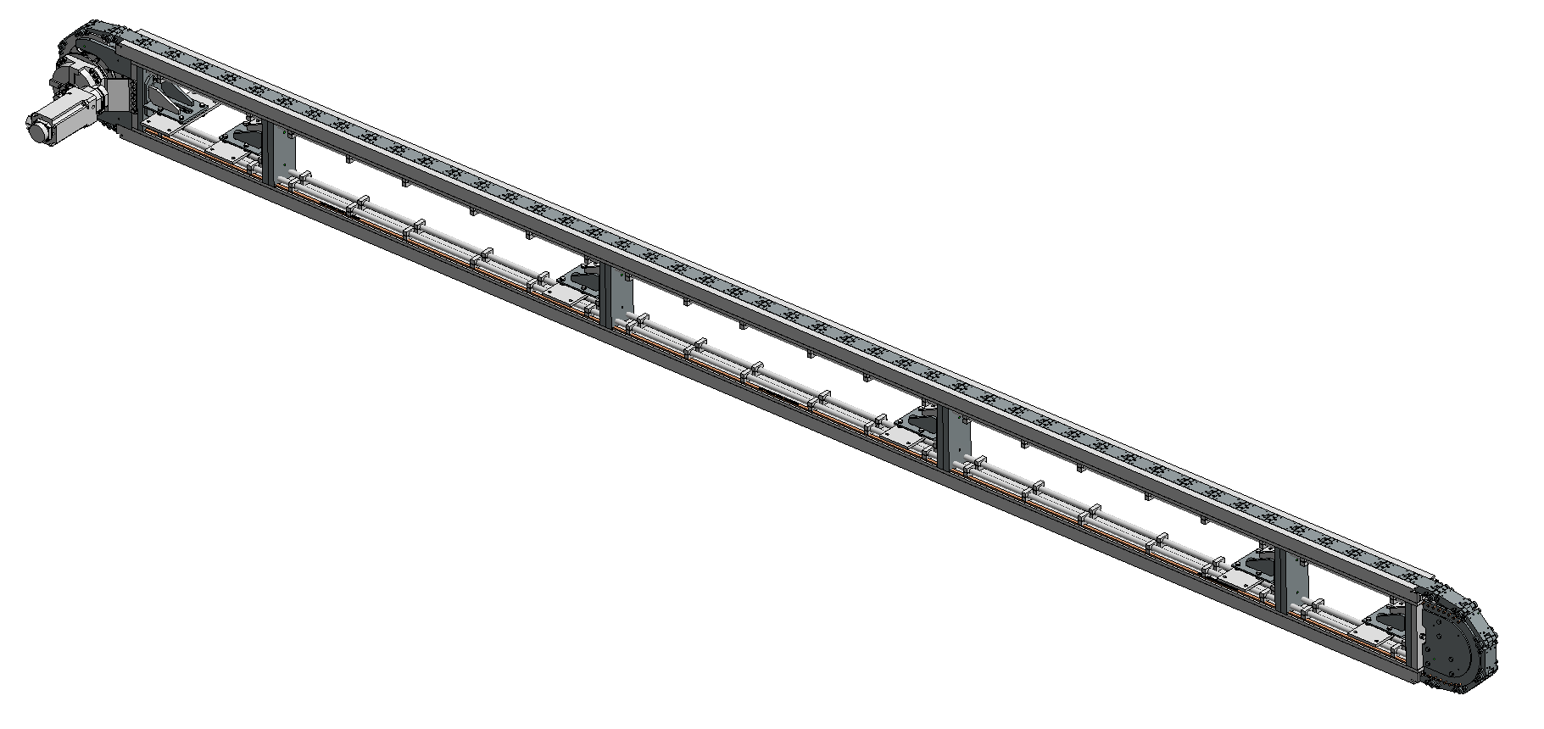
Transfer system
Station consisting of:
Transfer system
  Linear conveyor system
  21 process points
  Siemens SINAMICS S120
  Gear PSC_080H
  300mm stroke
  600ms cycle time
  Vertical orientation
  Mounting bracket for vertical installation
  Base frame
  Welding console
  Firmly anchored on the floor
  Slide plates for Cable
  WPC (48 pieces)
  Component query
  At each process point light barrier „Part available“

Slide 21
Control System
Control System
The control system essentially consists of the following components:
HMI: 19" Operator Center
Mobile Panel: KTP700F
Controller (PLC): CPU 151xF
Software: TIA Portal V17
Communication: Profinet
Decentralized Peripherals: MURR MVK
Centralized Peripherals: ET200SP
Servo Motor: SEW
Pneumatics: FESTO
Software
The PLC and control panels are programmed according to the Gluth standard.
Operation
The station is operated via a 19" touchscreen Operator Center panel.
One mobile panel is also provided.
Operator guidance is provided in German and Romanian.
Installation
The system is installed using the PROFINET Safety bus system.
Careful installation, especially of moving cables, is ensured.
Cables in Cable Carriers
In our experience, cables in cable carriers are subject to varying degrees of wear, depending on speed, acceleration, and frequency of movement. For this reason, these cables are designed to be plug-in or quickly replaceable. Regular system maintenance requires inspection and, if necessary, replacement.

Slide 22
Performance criteria – technical data
  Performance criteria - cycle time and output
  To determine the cycle time, a cable with a 16mm² cross-section and 170mm length is used.
  The station that is critical for the cycle time is the tinning of the cable ends.
  We are currently assuming a heating time of 2 seconds and a tinning time of 2 seconds.
  This gives us a cycle time of 6.5 seconds.
  If the current tests result in shorter or longer times for heating and tinning, we reserve the right to adjust the cycle time accordingly.
  Technical availability
  Technical availability: 98%
  Preliminary acceptance
  The preliminary acceptance of the system is carried out in Straubing.
  In a time window of 4 hours, one type each with 16mm², 25mm² and 32mm² is manufactured.
  Final acceptance
  The final acceptance of the system is carried out in Satu Mare.
  In a time window of 8 hours, one type each with 16mm², 25mm² and 32mm² is manufactured.

Slide 23
Scope of Delivery
The scope of delivery includes:
Creation of the mechanical design
  Mechanical design is carried out using Autodesk Inventor
  Initial meeting in Satu Mare, as well as necessary clarifications and design discussions in Straubing or via Teams
  Internal clarifications and support expenses
Creation of the hardware and software planning
  Hardware planning is carried out using EPLAN
  Software programming is carried out using Siemens TIA Portal
Procurement of purchased and manufactured parts (mechanical and electrical)
Assembly with electrical and pneumatic installation in-house
Final assembly and commissioning as well as preliminary acceptance of the system in-house
Disassembly, loading, and transport
  Transport to Satu Mare, Romania
Reassembly and commissioning at your factory
  Planned duration for reconstruction and commissioning: approximately 4 weeks
Training/instruction of your employees
Preparation of documentation
Project management
Weekly project meetings between Gluth and Dräxlmaier
Setting up and creating type data for two types each with a cross-section of 16 mm² 25mm², 32mm²
The scope of delivery does not include:
Procurement of supplies
Spare and replacement parts
Connection of the system to your internal power supply
  Pneumatics
  Electrical supply
  Facility suction
Installation and commissioning of types beyond the scope of delivery
ESD-compliant design

Slide 24
Supplies
  Supplies from Dräxlmeier
When placing an order, we request the following free of charge and on time:
Current drawings of all component variants
Samples of all individual parts and cable variants on coils
Consumables (e.g., solder)
Samples in the as-manufactured state, crimped and unsoldered
Pass/fail samples for camera selection
Pass/fail evaluation catalog for camera selection
Two crimping tools per type, based on design and coordination between Gluth and Dräxlmeier
MES test system or online access
Provision of the necessary power connections for the systems in your facility
  for pneumatics supply
  for electrical supply

Slide 25
Miscellaneous
Scope of Documentation:
The mechanical documentation is delivered once on a data storage medium in PDF format and consists of the following documents:
Assembly drawings with parts lists
Spare and wear parts lists
Pneumatic and hydraulic diagrams with parts lists
The electrical documentation is delivered once on a data storage medium (CD) and consists of the following documents:
Electrical diagram (EPLAN) with parts lists (additionally once in paper form for the control cabinet)
The software documentation is delivered once on a data storage medium (CD) and consists of:
Program source code
The software documentation does not include:
Program printout
Data flow diagram
The general documentation consists of the following documents:
Operating instructions with EC Declaration of Conformity (1x on paper in a folder)
Accessory documentation as standard documentation from the respective suppliers (1x in PDF)
Training/Instruction:
The instruction of your employees takes place as part of the commissioning over two days at your factory and includes:
Instruction on safety functions
Operation of the system
Instruction on the Testing procedures...
Troubleshooting
Maintenance
We ask that you release your designated specialist personnel and provide support from a German or English speaking employee.
Language
The system is available in German.
The following documents/components are available in Romanian:
Operating instructions
Operating and display texts
Accessory documentation (where available)
Electrical diagram (path designations)
Signage (where international symbols are not possible)
We ask for the assistance of your specialists to review or complete the translation.
Project Management
We appoint a primary project manager who will primarily be responsible for the following tasks:
Central contact for our customer, Gluth internally, and for the suppliers of components
Regular project status reports, as required by the project
Planning, implementation, and moderation of design FMEAs, as well as software concept discussions
Control of costs and deadlines
Clarification of interfaces for components, in particular
Support in conducting acceptance tests for components (especially interface reviews)
Clarification and recording of any changes (change management)
However, we request support from the relevant departments, particularly with regard to existing process and product experience. This experience should be incorporated, especially in the early project phase. We would also like to point out that the customer is responsible for deadlines for components.
Technical and organizational changes during the project
If the customer subsequently requests technical or organizational changes that result in an additional charge or a delay in delivery, Gluth will provide a cost estimate or specify the delay.
Implementation of technical changes requires that the customer has placed an order for them and that Gluth has confirmed this with a corresponding order confirmation or project plan.

Slide 26
Miscellaneous
Service – Maintenance – Liability
Service Response Time
Our qualified specialists will be available on-site within two days to return the system to production status as quickly as possible. This policy applies if the request is received Monday through Thursday between 7:00 am and 4:00 pm. For service calls received after 4:00 pm, the above-mentioned deadline begins at 7:00 am on the following business day. For service calls received on Fridays after 12:15 pm., the above-mentioned deadline begins at 7:00 am on the following Monday, or by arrangement via permanent service telephone numbers.
This response time is only valid for the Satu Mare location.
Our company is also available on weekends and public holidays via permanent service telephone numbers. In an emergency, we will try to organize the appropriate staff to ensure you receive professional support. If telephone support is not successful, we are also available to carry out emergency service calls on weekends. Necessary, foreseeable assignments on weekends or holidays will be carried out after consultation with you.
Liability for Material Defects
Liability for material defects is 24 months, without shift restrictions, beginning on the day of handover to your premises, but no later than four weeks after delivery. For purchased parts, the period begins upon receipt at our premises. Excluded are spare and wear parts, as well as components supplied by the supplier.
Liability for material defects applies only to newly delivered components.
Liability for Assembly Work
We are liable for damages caused by us, our vicarious agents, or our subcontractors within the scope of the statutory provisions with the following liability insurance policies (maximum coverage amounts):
Business and product liability insurance:
Persoinjury and property damage (flat rate) EUR 10.000.000
Fire and explosion damage EUR 5.000.000
Industrial damage EUR 100.000
Financial loss EUR 100.000
Environmental liability insurance
Personal injury and property damage nal (flat rate) EUR 1.500.000
We cannot accept liability for amounts exceeding this amount.
  Disclaimer
We cannot accept liability for damages and consequential damages caused by improper use or tampering with our equipment by the operator. We also generally exclude liability if products manufactured on our equipment do not comply with legal regulations or if their use violates legal regulations.
Offer Documents
All documents provided as part of the offer process remain our property. This applies in particular to layout and concept proposals, as well as presentation materials. Any other use or disclosure to third parties requires our written consent.

Slide 27
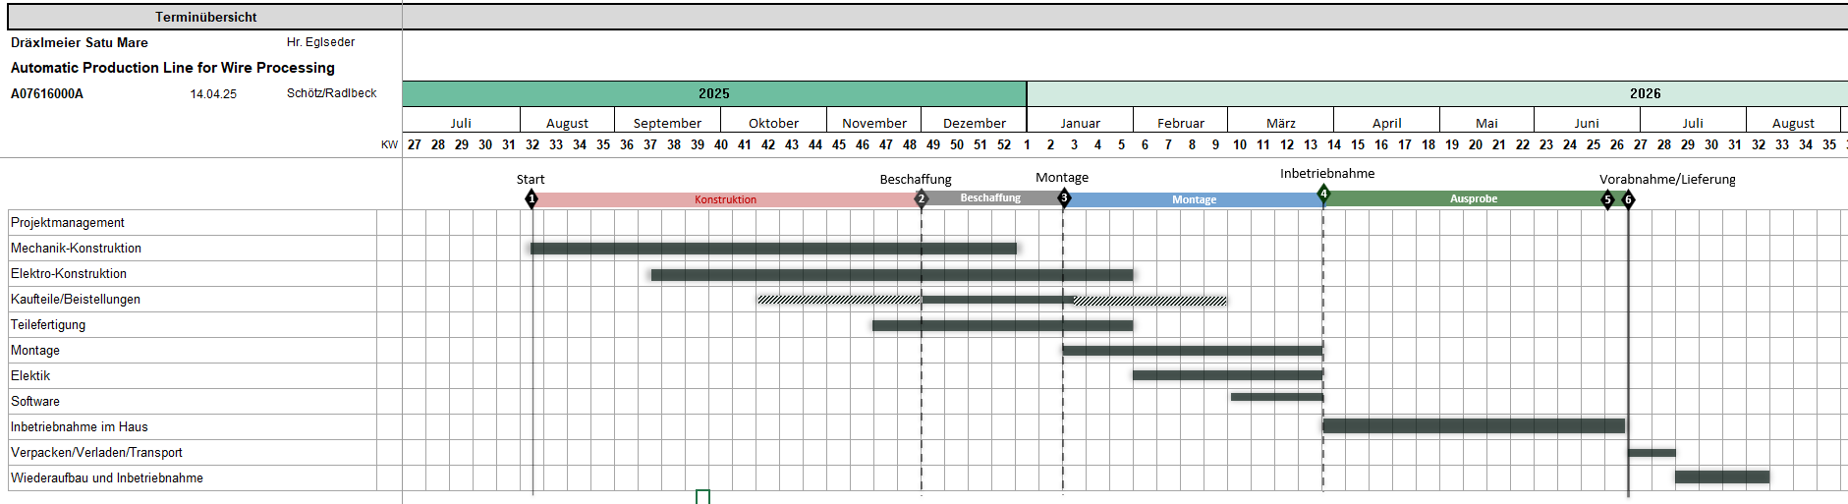
Project Schedule

Slide 28
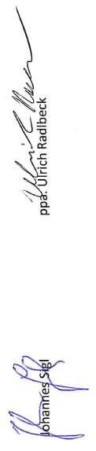
Project Prices
Basic Scope „Automatic Production Line“ 1.764.000 €
Transport and Comissioning in Satu Mare 109.000 €
Instruction and Training 11.000 €
Documentation 23.000 €
Project Management 88.000 €
Sum total „Automatik Production Line“ 1.995.000 €
Option 1: Insert Shrink Sleeve 85.500 €
Option 3: Labeling 60.500 €
Option 4: Output with buffer for Boxes 76.000 €
Project sum: 2.217.000 €
Reduced Project Price: 1.818.000 €
Pricing
All prices in euros and subject to statutory VAT.
Payment
30% upon order placement, against deposit
60% upon delivery
5% upon handover in a ready-to-use condition
5% upon acceptance, but no later than 4 weeks after the handover if final acceptance is delayed for reasons attributable to the customer.
Note: Upon delivery, we will issue a final invoice for 100% with the corresponding payment terms.
Payment term:
Down payment:
- Invoicing upon order
- due date and deposit: 05.01.2026
Others:
- 45 days
Offer validity:
Our prices have a validity period of 60 days, calculated from the date of offer.
Delivery:
DAP Satu Mare plant
We would be pleased to receive your valued order and
remain with kind regards

